Slide 1
Machine learning
Chris Geggis
2/23/2023

Slide 2
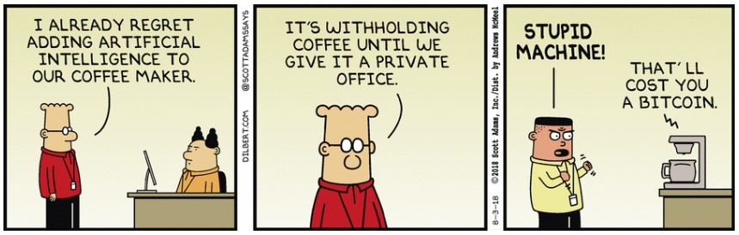
Attendance OR QUIZ?

Slide 3
THEORY OF LEARNING
Computational learning theory lies at the intersection of AI, statistics, and theoretical computer science
A hypothesis that is seriously wrong will be discredited with a high probability after a small number of examples
A hypothesis that is consistent after a large set of training examples is probably approximately correct
The number of required examples to get to probably approximately correct can be approximated mathematically and is called the sample complexity
If the error rate is low, the hypothesis is approximately correct

Slide 4
Linear regression and classification
Linear functions, aka “fitting a straight line”, is one of the oldest tricks in the book
y = mx + b, or y = w₁x + w₀ (weights in the book)
The task of finding the best fitting line (aka hypothesis in ML terms) is called linear regression
There is a lot of math in the book which details the traditional methods for finding the best fitting line
The weight space is all of the possible setting for the weights
The following figure shows a best fit line, and a loss function which is convex

Slide 5
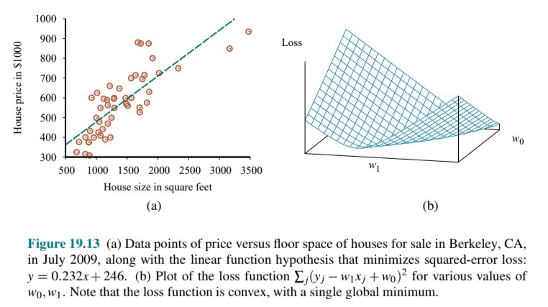

Slide 6
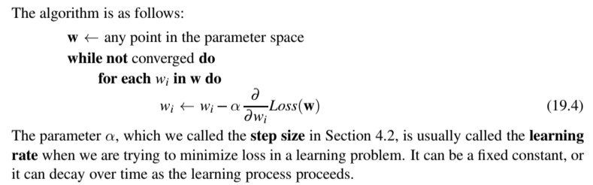
Learning rate

Slide 7
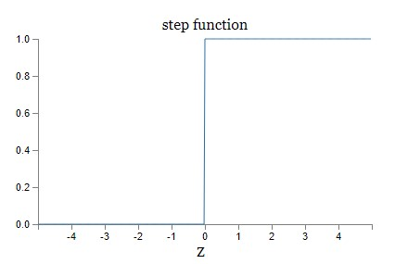
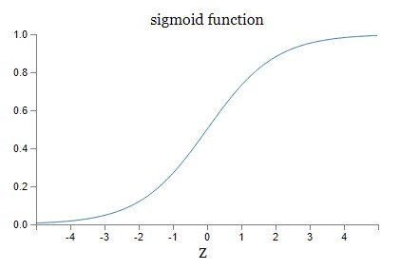
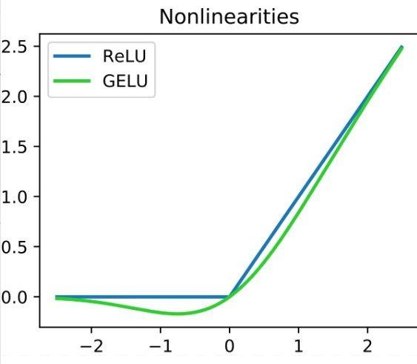
Learning rate and step function
GELU = Gaussian-error linear unit
Smooths out ReLU

Slide 8
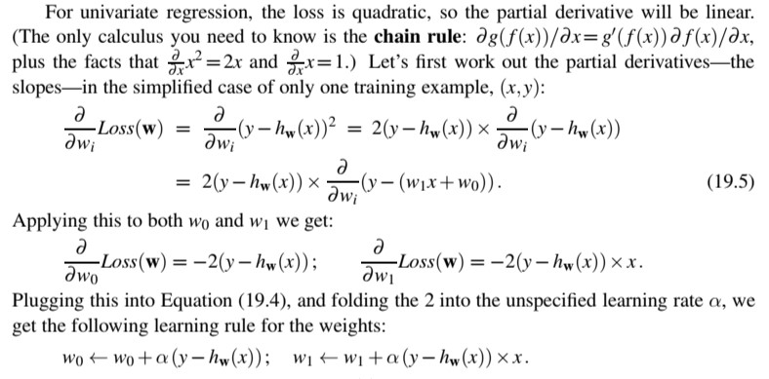
Stochastic gradient decent (math)

Slide 9
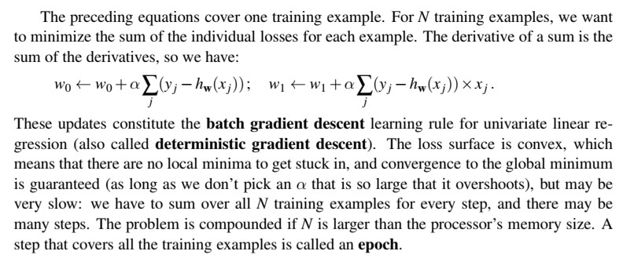
more math and gradient descent

Slide 10
Assignment 3
net = network.Network([784, 30, 10])
30 perceptrons in the hidden layer (can also be a hyperparameter)
net.SGD(training_data, 30, 10, 3.0, test_data=test_data)
30 - epochs, 10 - mini-batch size, 3.0 - learning rate
A mini-batch of size one is called online or incremental learning (from Nielson, ch. 1)
99.79 % is (or possibly was) the “world record” accuracy for ML with the MNIST data set

Slide 11
Gradient descent
Stochastic gradient descent is faster than batch gradient descent.
SGD updates according to Equation 19.5 (back a few slides)
The minibatch speeds things up because some calculations are only performed once
SGD is also known as online gradient descent, which is NOT the same as online learning

Slide 12
Multivariable linear regression
(Sort of) explained in the 3blue1brown video
https://www.youtube.com/watch?v=IHZwWFHWa-w&list=PLZHQObOWTQDNU6R1_67000Dx_ZCJB-3pi&index=2&ab_channel=3Blue1Brown

Slide 13
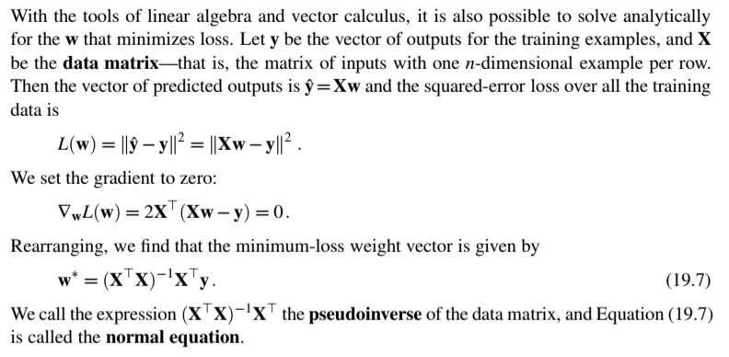
The matrix

Slide 14
Symbols
Calculus section – ∇ = Nabla, the gradient, or vector derivative operator
Other brackets section - || = The norm of an element of a normed vector space (out of 3 possibilities)
Not in Mathematical symbols table, had to Google T (superscript) = Transpose (matrix)

Slide 15
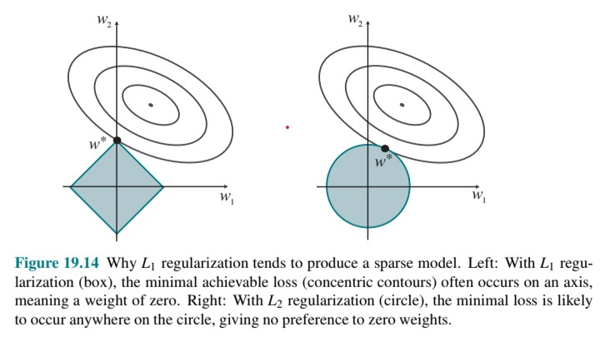
Sparse Model
L₁ regularization produces a sparse model which often sets many weights to zero
This has advantages (less overfitting, and more understandable) and disadvantages, so it depends on the situation

Slide 16
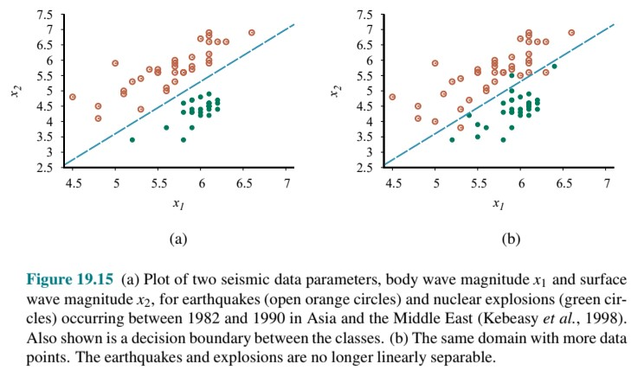
Linear classifiers with a hard threshold
A decision boundary separates two classes. A linear decision boundary is called a linear separator.

Slide 17
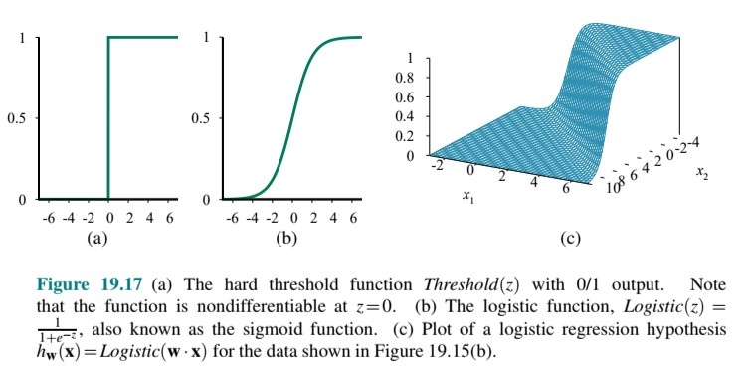
Threshold Function

Slide 18
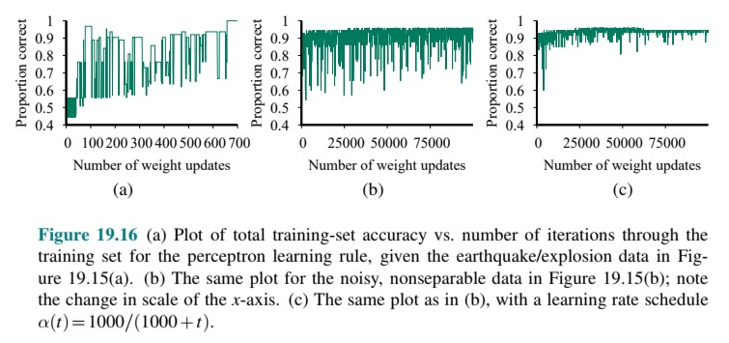
Perceptron learning rule
Note the decrease in the threshold function as t (the number of iterations) increases
This results in a faster convergence to a higher proportion correct
The process of fitting the weights to a model to minimize loss is called logistic regression

Slide 19
Nonparametric models
A learning model that summarizes data with a set of parameters of fixed size (independent of the number of training examples) is called a parametric model.
A nonparametric model is one that cannot be characterized by a bounded set of parameters. This method retains all of the data points as part of the model.
These are also known as instance-based learning or memory-based learning methods
The simplest instance-based learning method is table lookup. All of the training examples are put into a table. The biggest problem with this method is that it does not generalize well.

Slide 20
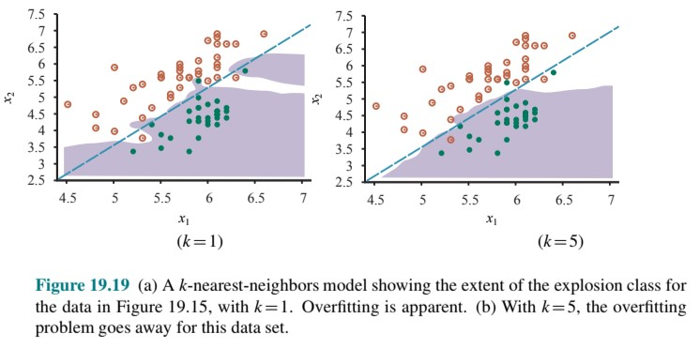
Nearest-neighbor models
k-nearest neighbors model is an improvement over table lookup
k is usually set to an odd number to avoid binary classification

Slide 21
Nearest distance metrics
Distances are usually measured with a Minkowski distance with a formula that you don’t need to memorize, but is in the book for reference
If you plug different values into the formula you can get a Euclidean distance, a Manhattan distance (covered in Ch. 3, which we skipped), or a Hamming distance.
A common approach is to apply normalization to the measurements in each dimension
There is also a more complex metric known as the Mahalanobis distance which takes into account the covariance between dimensions
In low dimensions, with plenty of data, nearest neighbors works well. At higher dimensions nearest neighbors does not work well. This is called the curse of dimensionality.

Slide 22
K-d trees
k-d trees are the balanced binary tree equivalent in multiple dimensions

Slide 23
Locality-sensitive hashing
For faster lookup hash tables are often used over binary trees, but the keys are somewhat randomly assigned and require exact matching
To get around the randomness and exact matching we want a locality-sensitive hash.
In other words, try to make the keys the nearest neighbors

Slide 24
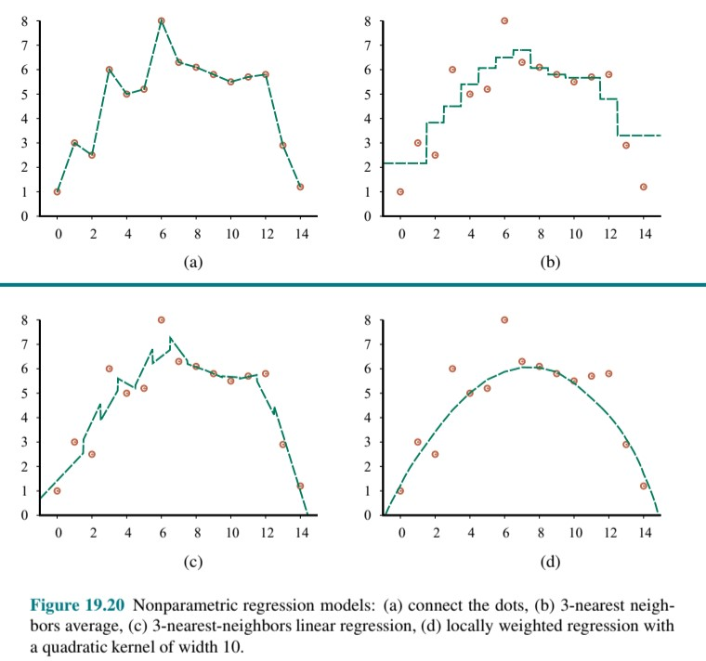
Nonparametric
Regression
Models

Slide 25
Support vector machine (SVM)
SVMs construct a maximum margin separator – a decision boundary with the largest possible distance to example points, which helps them generalize well
SVMs can embed the data into a higher-dimensional space using the kernel trick (the book has the math)
SVMs combine the advantages of nonparametric and parametric models. They have the flexibility to represent complex functions, but they are resistant to overfitting.
scikit-learn Python package can create SVMs

Slide 26
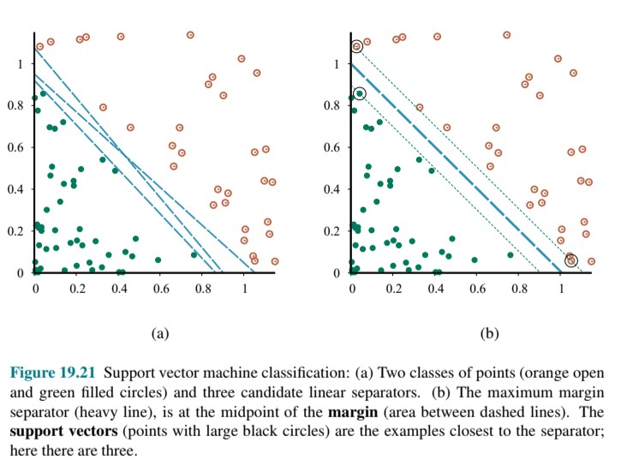
Support Vector Machines look for the maximum margin separator

Slide 27
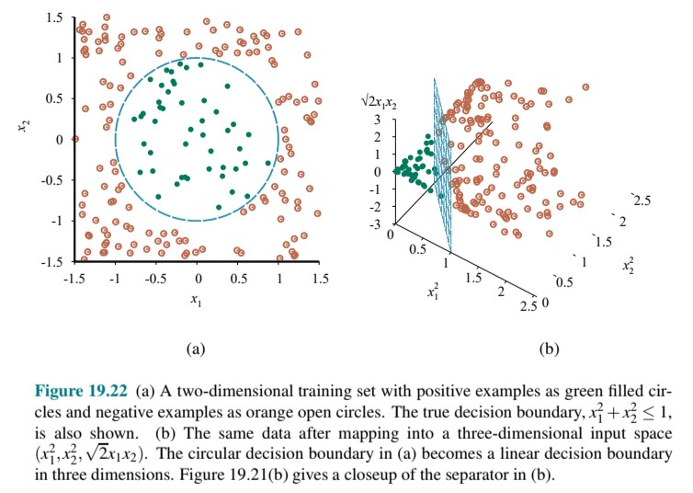
In general, if data are mapped into a space of sufficiently high dimension, they will almost always be linearly separable

Slide 28
Ensemble learning
Ensemble learning selects a collection (or ensemble) of hypotheses and combines their predictions by averaging, voting, or some other means of machine learning
We call the individual hypotheses base models and their combination an ensemble model.
An ensemble model may reduce bias and be more expressive than a single hypothesis
An ensemble model may also reduce variance. One hypothesis may be wrong. Three out of five hypotheses are more likely to be right.

Slide 29
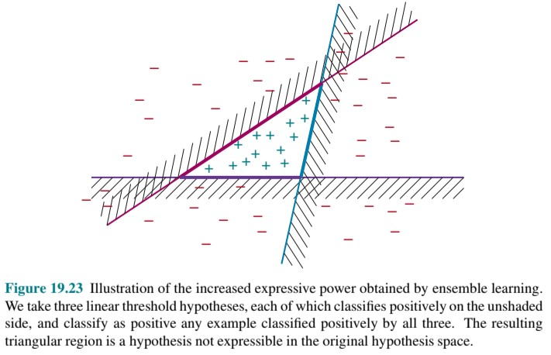
Ensemble learning

Slide 30
Ensemble learning - Bagging
Bagging is short for “bootstrap aggregating”
Generate K distinct training sets by sampling N examples from the training set
Run the ML algorithm on the N examples
Repeat the above step K times
Bagging can correct overfitting and reduce variance

Slide 31
Ensemble learning – Random forests
The random forest model is a form of decision tree bagging in which we take extra steps to make the ensemble of K trees more diverse, to reduce variance
Random forests can be used for classification of regression
The key idea is to randomly vary attribute choices as opposed to training examples
At each split point in constructing the tree, we select a random sampling of attributes and then compute which of those gives the highest information gain
If there are n attributes, a common default choice is that each split randomly picks √n attributes for classification, or n/3 for regression problems

Slide 32
Ensemble learning – random forests
To improve further, we can randomly select the split point value for attributes
We randomly sample several candidate values from a uniform distribution over the attributes range
Select the value that has the highest information gain
This makes it more likely that every tree in the forest will be different
These are called extremely randomized trees (or ExtraTrees)

Slide 33
Ensemble learning – random forests
Random trees are surprisingly efficient to create
Random trees are resistant to overfitting
Random trees were winning data science competitions in the early 2010s
Random trees are used in a wide variety of applications

Slide 34
Ensemble learning - Stacking
Stacked generalization (or stacking) combines multiple base models from different model classes trained on the same data
For example, using the restaurant decision tree as an example
Stacking reduces bias and has the advantage that individuals can work independently and then come together to build a final stacked ensemble model

Slide 35
Ensemble learning - Boosting
Boosting is the most popular ensemble method (according to the book)
Boosting uses a weighted training set
All examples start with an equal weight of 1during training
Weights are increased if the training example fails
Boosting can overcome any amount of bias in the base model
Boosting approximates Bayesian learning
Predictions improve as the as the ensemble hypothesis becomes more complex (counterintuitive)

Slide 36
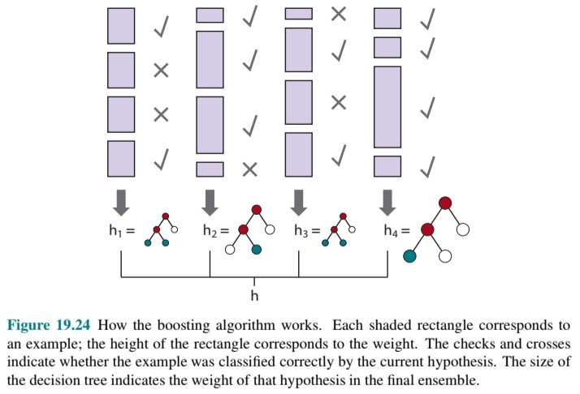
Boosting algorithm

Slide 37
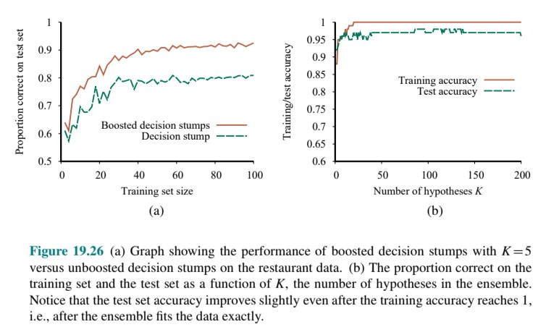
Boosting the restaurant data performance

Slide 38
Ensemble learning – gradient boosting and online learning
Gradient boosting is a form of boosting that uses gradient descent, as opposed to weighted examples
Online learning uses a randomized weighted majority algorithm which helps in situations where past results do not necessarily predict the future (think financial markets). Good predictors attribute weights are adjusted as time marches on.
Note that the definition of online learning differs between the Russell/Norvig book and the Nielson book (where online learning means a mini-batch size of 1)

Slide 39
Developing machine learning systems
Problem formation – “What problem do I want to solve for my users?”
Semisupervised learning has become a common approach. i.e. given a few labeled examples, use them to mine more information from a large collection of unlabeled examples
The field of weakly supervised learning focuses on using labels that are noisy, imprecise, or supplied by non-experts

Slide 40
Data collection, assessment, and management
Sometimes data is manufactured, or created by labor/capital
Crowdsourcing uses paid workers or unpaid volunteers operating over the Internet
Waze and DuoLingo are good examples of crowdsourcing
A good practice is to maintain data provenance for all of your data
Carefully consider unbalanced classes, under-sampling, over-sampling, and outliers in your data
The book gives good examples of questions to ask yourself, and possible solutions

Slide 41
Trust
Source control: Systems for version control, build, and bug/issue tracking
Testing: Unit tests for all components, fuzz tests (random inputs), regression tests, load tests, system integration tests. For ML, training, validation, and test data sets
Review: Code, privacy, fairness, and other legal compliance reviews
Monitoring: Dashboards and alerts to make sure the system is up and running
Accountability: What happens when the system is wrong? What is the process for complaining or appealing the system’s decision? How can we track who was responsible for the error?

Slide 42
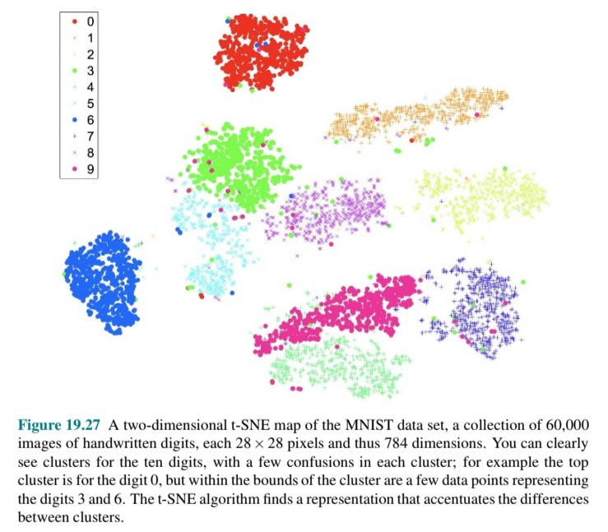

Slide 43
CS Movie - pick of the week
WALL·E (2008) (Not to be confused with DALL·E)
In the distant future, a small waste-collecting robot inadvertently embarks on a space journey that will ultimately decide the fate of mankind.

